Slide 1
ROTOR HUB AND PITCH SYSTEM (WIND ENRGY PROJECT “2024-2025”)
WEEK – 01 (Introduction of Pitch systems)
Function of Pitch system
Classification of Pitch System
Components of Electrical system
Components of hydraulic system
Comparison of Electrical and Hydraulic Pitch system
Standards For Pitch system
Guide :- Prof. Christian Bulligk
Mostafa Mozafary Eslam Sameh Rahul Patil

Slide 2
Function of Pitch system
The Function of the Pitch system is to control the angle of blades according to the wind speed.
Power Optimization
Power limitation
Protecting from Over speeding
Start and stop of wind turbine
Pitch Actuators
Gear
Blades

Slide 3
Classification of Pitch System
Pitch system
Electric system
Hydraulic system
Accumulators (backup)
Internal
External
Capacitors or Battery (Backup)

Slide 4
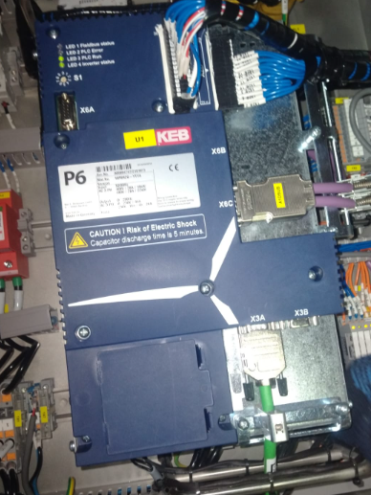
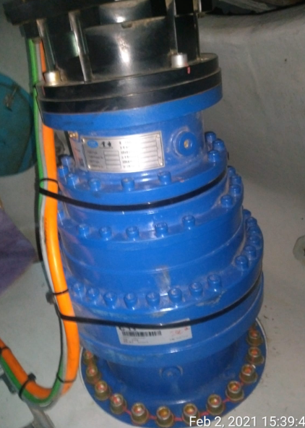
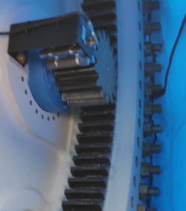
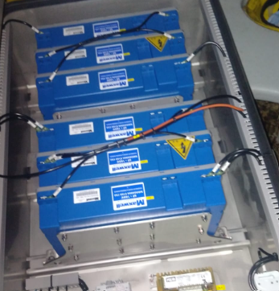
Components of Electrical pitch System
Pitch controller
Pitch motor
Pitch drive
Pitch bearing
Battery backup System
Pitch Angle encoder

Slide 5
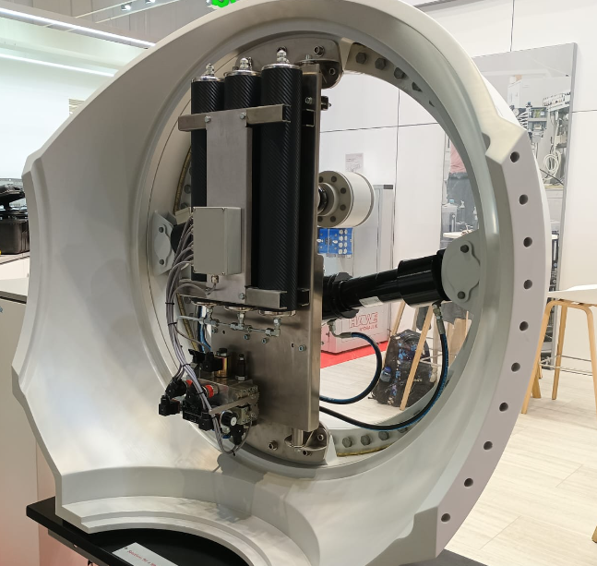
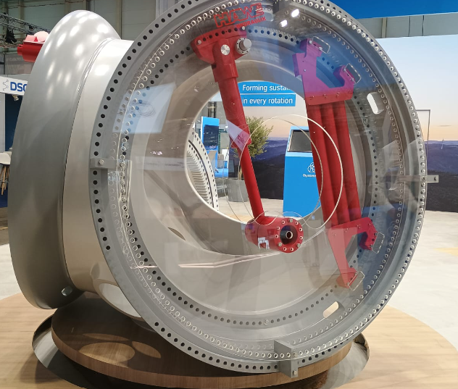
Components of Hydraulic pitch System
Controller
Hydraulic Pump
Actuator (Piston and cylinder)
Reservoir
Accumulator
Pitch bearing
Pitch Angle encoder

Slide 6
Comparison of Electrical and Hydraulic Pitch system
Electrical System
Quick response
Lower Maintenance
Low Operation cost
More Efficient
More components
Complex system
More prone to breakdown
Limited life of battery or capacitors
Hydraulic System
Produce Hight torque
Simple layout and easy to understand
Chances of Leaking of oil
High Maintenance
Slightly slower
High installation and Maintenance cost

Slide 7
Relevant standards and guidelines:
Assessment documents
For the components specifications and assembly drawings shall be submitted
Assembly and sectional drawings (associated parts lists and if applicable individual , part drawings, description explaining the functional principle of the blade pitching system.)
The calculations for the verification of the components of the blade pitching system shall be presented.
Evaluation of Pitch Teeth: Required Drawings for Pitch Gearbox Systems (Pitch Pinion, Pinion shaft, blade bearing teeth)
The analysis of: the pitch gearbox teeth, the blade bearing teeth, the blade bearing teeth, load capacity considering the fatigue loads, static strength against tooth breakage and pitting, Fatigue strength and static strength for the output shaft of the pitch gearbox and for the connecting elements of a pitch system
In the case of hydraulic actuator, dimensioned drawings with the maximum and minimum positions the positions in which the greatest loads act on the blade pitching mechanism.
fatigue strength analysis and static strength analysis for all loads.

Slide 8
Relevant standards and guidelines:
Loads to be applied
The static and load-dependent bearing friction moments shall be taken into account.
Fatigue Analysis (Load Considerations)
Use Load Duration Distributions (LDD) or Load Spectra
Distinguish Between Operation With and Without Blade Pitching
Include Additional Inertial Loads from Rotor Rotation
Consider Dynamic Vibration-Exciting Loads
- Static Strength Analysis for Pitch Systems
Analyze With and Without Blade Pitching Operation
Use Design Loads from the Dimensioning Load Case
If Maximum Torque is Exceeded:
Consider Torque from Pitch Motor Brakes or Hydraulic Pressure
Use Maximum Torque Generated by the Pitch System for Analysis

Slide 9
Relevant standards and guidelines:
Loads to be applied
Blade Bearing Teeth Stress Analysis
Teeth are Stressed on a Small Part of Their Circumference
Maximum Rotation Angle Between Start and Stop: ~90°
Load Cycles for Gear Calculation:
Determine Appropriately
Multiply by Factor Based on Sector of Teeth Used
- Rotary Drive Systems: Strength Analysis
Use Application Factor: KA = 1.0
Applies to Static and Fatigue Strength Analysis

